Slide 1
Extracting Content From Image

Slide 2
Introduction to the System
Input an image with barcode and get only barcodes
Input a non barcode image get a spam notification

Slide 3
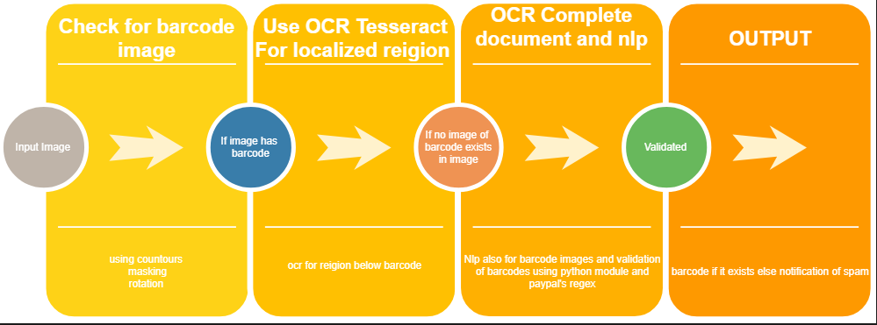
Application flow
`

Slide 4
Method for extraction of barcodes
Resize the image
Check for rotation
Find top 5 contours
Mask it
Localize bar code
Ocr of localized region
Ocr of complete document If no barcode image exists
NLP of the text
Validate it

Slide 5
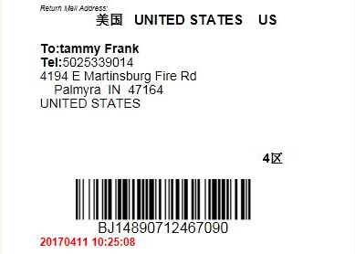

Samples
Input
Output

Slide 6
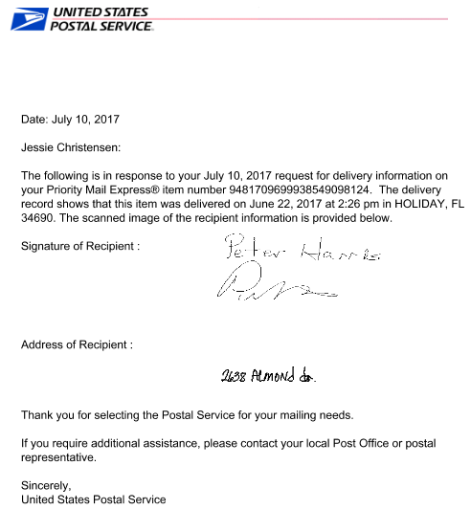

Non barcode Image output
input
Output

Slide 7
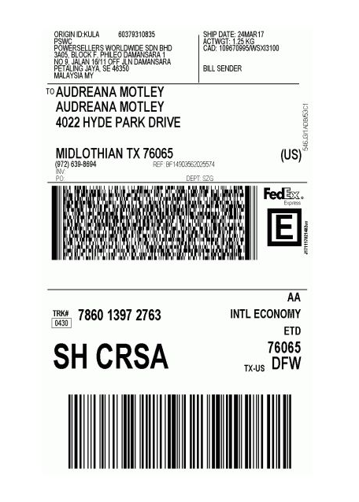
Critical analysis
input
Errors due to multiple small numbers of barcode type at the top

